Slide 1
AML Archetype Modeling Language Improving interoperability of information models
Pre-Thesis Seminar
By
Deepak Sharma
Master of Science
Biomedical Informatics & Computational Biology
University of Minnesota, Rochester
April 23, 2015

Slide 2



Advisers
Dr. Christopher G. Chute, MD, Dr. P.H.
Bloomberg Distinguished Professor of Health Informatics,
Professor of Medicine, Public Health, and Nursing,
Chief Health Information Research Officer,
Johns Hopkins Medicine Professor,
Johns Hopkins, Baltimore, Maryland.
Dr. Claudia Neuhauser, Ph.D.
Director of Informatics Institute,
Interim Director, Minnesota Supercomputing Institute,
Office of the Vice President for Research,
Director of Graduate Studies, Biomedical Informatics & Computational Biology
University Of Minnesota, Minneapolis, Minnesota.
Dr. Guoqian Jiang, MD, Dr. Ph. D.
Associate Professor of Biomedical Informatics,
Associate Consultant in Department of Health Sciences Research,
Division of Biomedical Statistics & Informatics,
Mayo Clinic College of Medicine,
Rochester, Minnesota.

Slide 3
Agenda
The interoperability problem.
Archetypes - Constraint Modeling.
CIMI - Clinical Information Modeling Initiative.
Existing Frameworks & Tools.
AML - Archetype Modeling Language.
AML Tooling.

Slide 4
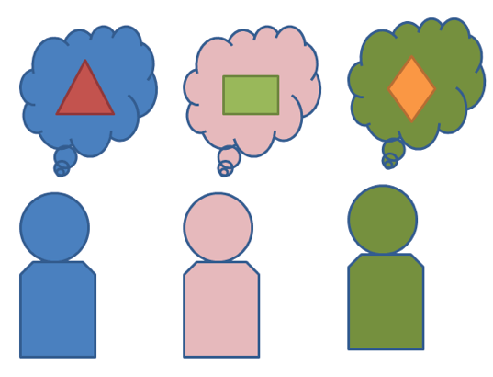
Interoperability Problem
Exchange or share information:
How to be “On The Same Page”?
Data
Semantics

Slide 5
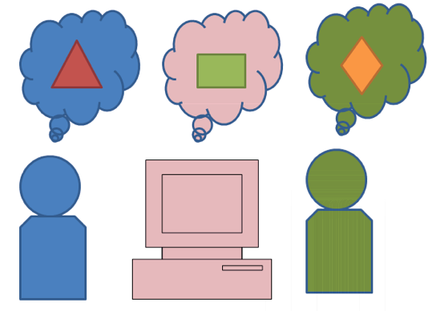
Interoperability Problem
Standards - Model/Schema/Metadata
Proprietary (not shared freely)
Finding semantics – mapping, transforms
Multiple
organizations
systems

Slide 6
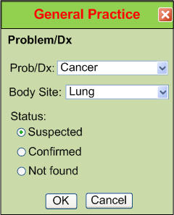
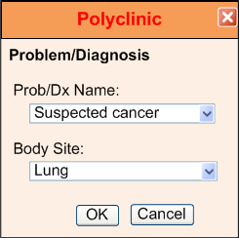
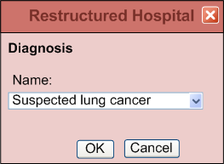
IsoSemantic Models – Example of Problem (from Dr. Linda Bird)
e.g. “Suspected Lung Cancer”
Courtesy: Dr. Stanley M. Huff (Intermountain Healthcare), and Dr. Linda Bird

Slide 7
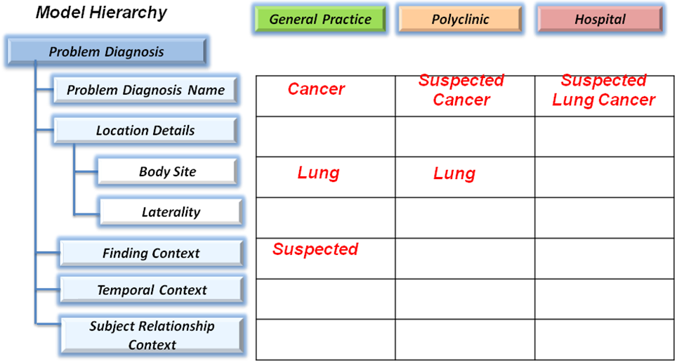
IsoSemantic Models – Example Instances (from Dr. Linda Bird)
e.g. “Suspected Lung Cancer”
Courtesy: Dr. Stanley M. Huff (Intermountain Healthcare), and Dr. Linda Bird

Slide 8
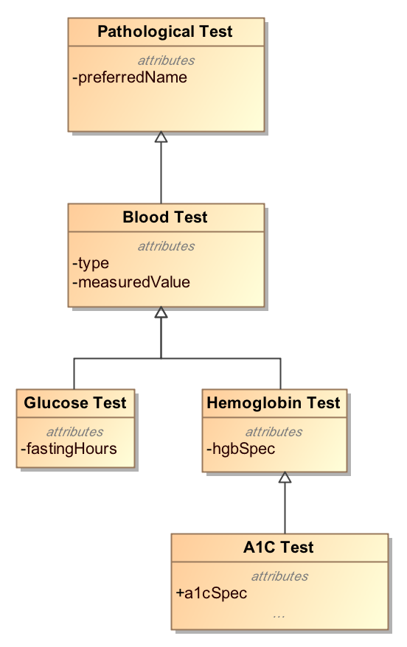
Modeling Approach
Top-Down Modeling
Generic → Specific
At each level we specialize
Properties
Associations

Slide 9
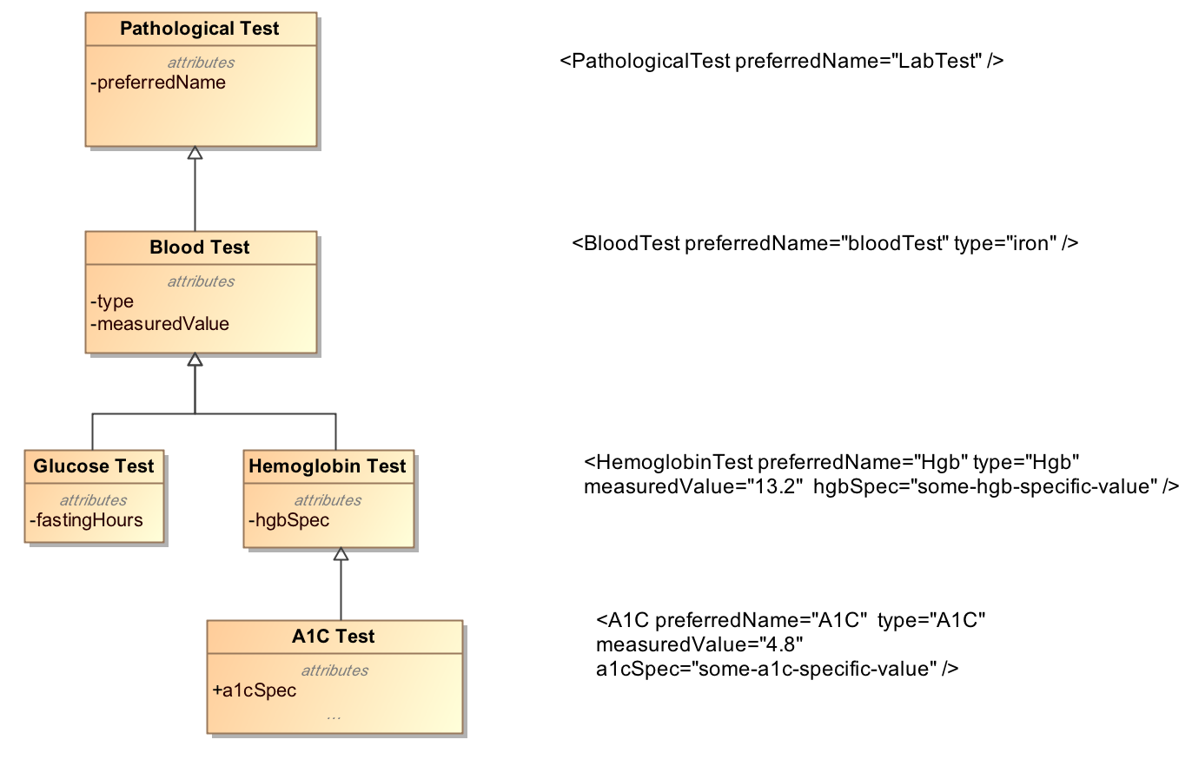
Top-Down Modeling Approach

Slide 10
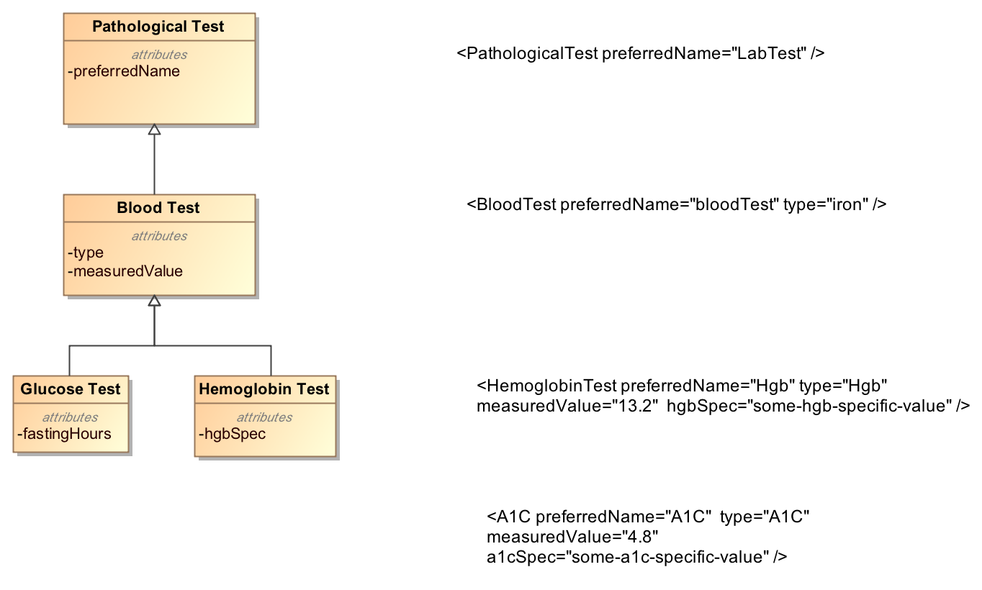
Top-Down Modeling Approach
???

Slide 11
Bottom-Up Modeling Approach
Constraint or Bottom-up Modeling
Start with a general model
Becomes the most abstract level of exchange
Specialize by
Cardinality
Values and value ranges
Optional/Mandatory/Prohibited
Enumeration subsets
Renaming
Courtesy: Harold Solbrig

Slide 12
Bottom-Up Modeling Approach
Example
Abnormal A1C Test = Set of Constraints
Pathological Test {0..*}
Has measuredValue {1..*}
measuredValue > Some_Threshold_Value
Type == “A1C”

Slide 13
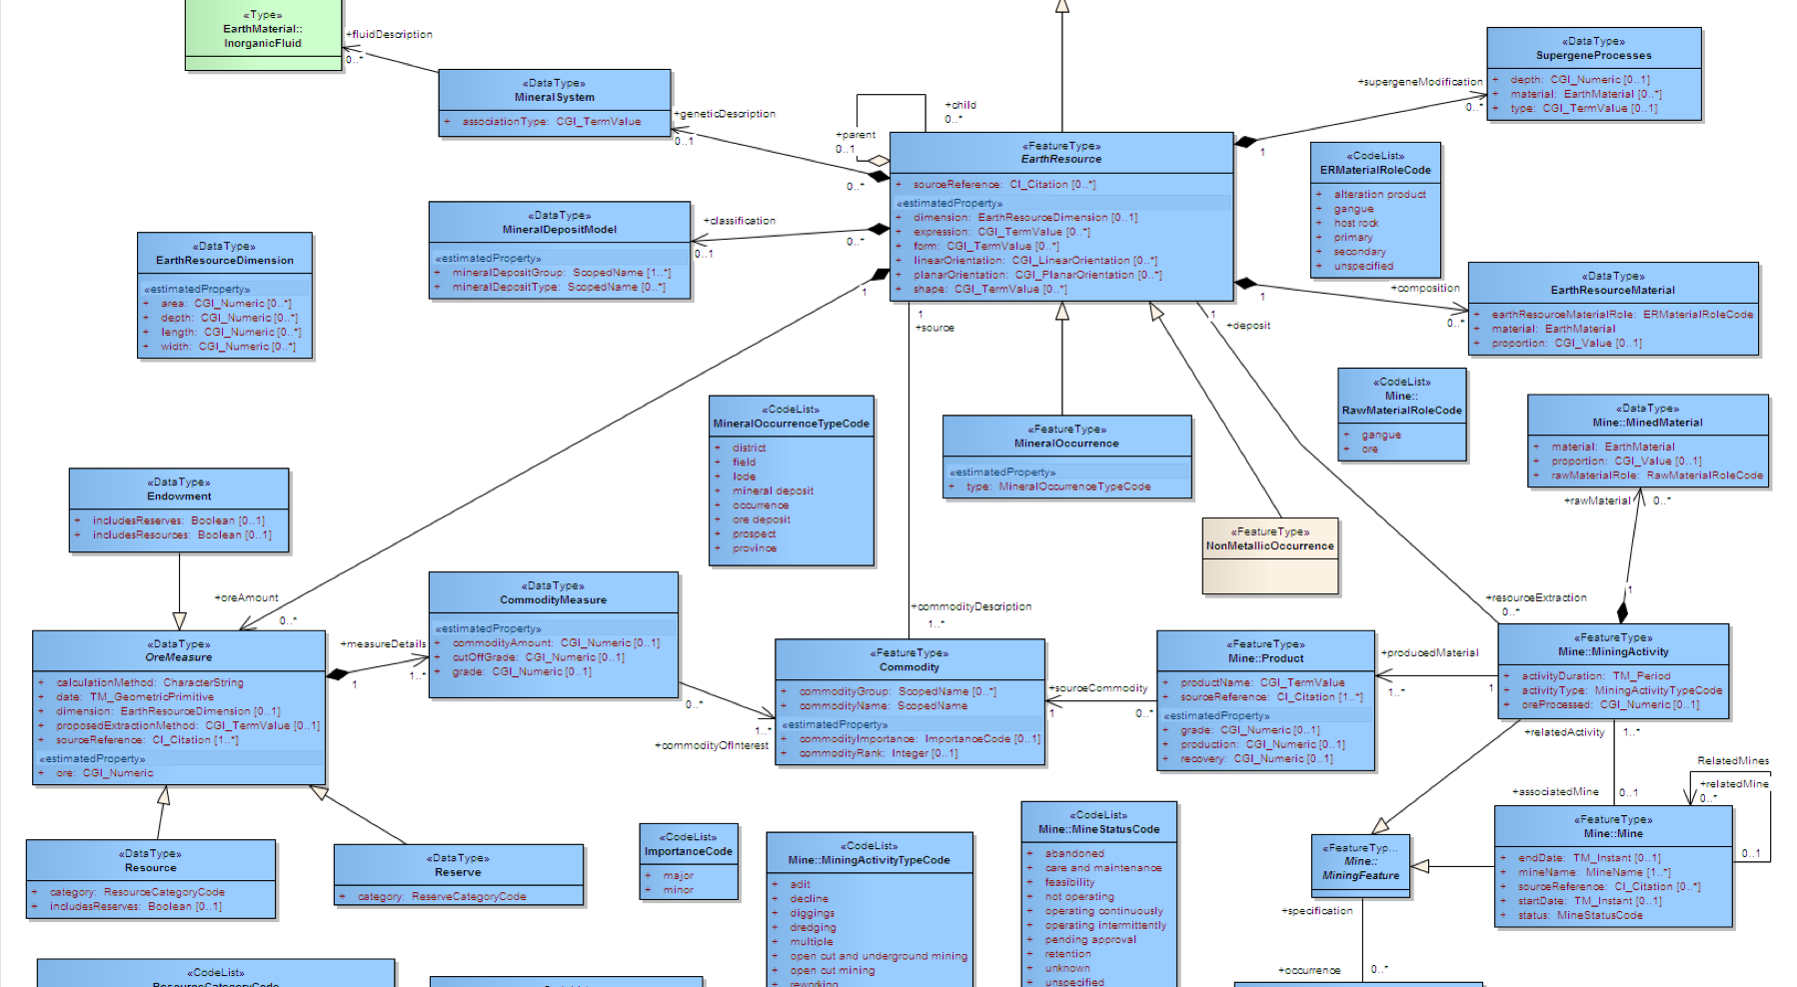

Archetype
“about”
Reference Model
Constraints on Reference Model Elements
Archetype

Slide 14
Archetypes
Reference Model
Archetype
Library

Slide 15
Without Archetypes
Reference Model
Application
codes constraints:
Pathological test == “A1C”,
measuredValue > threashold value
….
Other constraints

Slide 16
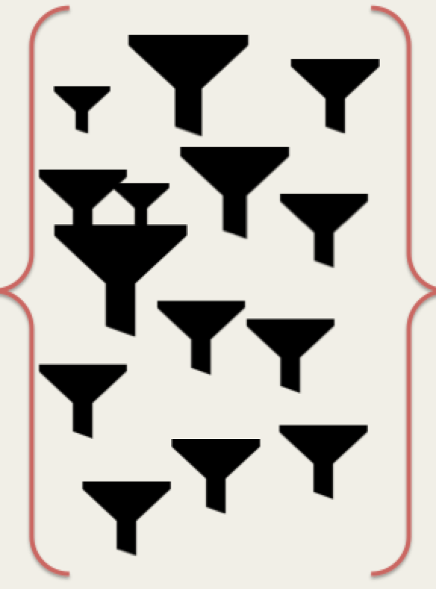
With Archetypes
Reference Model
Application
Archetypes

Slide 17
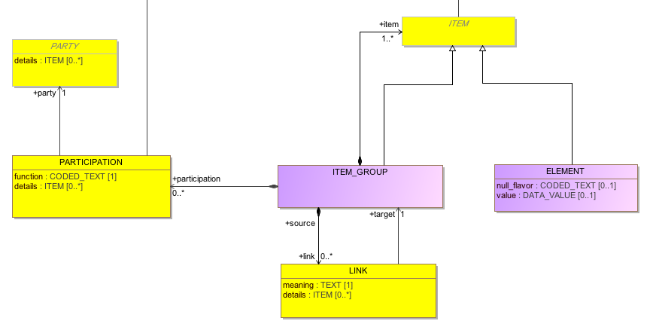
Reference Model Example
CIMI Reference Model

Slide 18
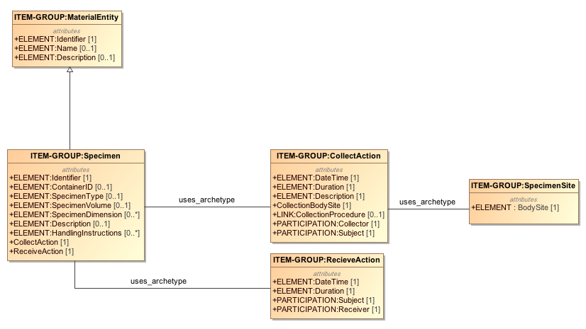
An Archetype Example
Simple Example: Specimen collection from a body site.
RM

Slide 19
Detailed Clinical Models
We can create …. For example
A Clinical Model => Laboratory Test
Diagnostic Service
Specimen
Diagnosis
Conclusions
And others like… Clinical Statements, Reports, Procedures, …..so on
“Shared Detailed Clinical Information Models”

Slide 20

Clinical Information Modeling Initiative
Since 2011
http://www.opencimi.org/
Mission Statement:
Improve the interoperability of healthcare systems through shared implementable clinical information models.
(A Single Curated Collection)

Slide 21
CIMI – Strategic Goal
Be able to share data, applications, reports, alerts, protocols, and decision support modules with anyone in the WORLD.
To have “plug-n-play” interoperability.
Source: http://www.opencimi.org/

Slide 22
CIMI – Deliverables
Shared repository of detailed clinical information models.
Using a single formalism (now support of two!) – ADL & AML.
Based on a common set of base data types.
With formal bindings of the models to standard coded terminologies.
Repository is open and models are free for use at no cost.
Models that support multiple contexts.
Source: http://www.opencimi.org/

Slide 23
CIMI – Target Domains
EHR data storage.
Message and service payload.
Decision logic (queries of EHR data).
Clinical trials data (clinical research).
Quality measures.
Normalization of data for secondary use.
Creation of structured data entry screens.
Capture of coding output from NLP.
Source: http://www.opencimi.org/

Slide 24
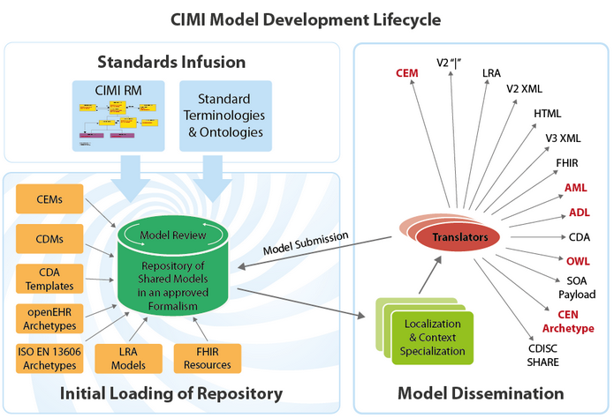
CIMI – Shared Repository
Source: http://www.opencimi.org/

Slide 25
CIMI – Coded Elements
Model Elements are bound to Standard Terminologies and Ontologies:
SNOMED CT - primary and preferred.
Systematized Nomenclature of Medicine – Clinical Terms
LOINC - approved.
Logical Observation Identifiers Names and Codes
CIMI SNOMED CT Identifier for extension.
Value-sets only by reference.

Slide 26
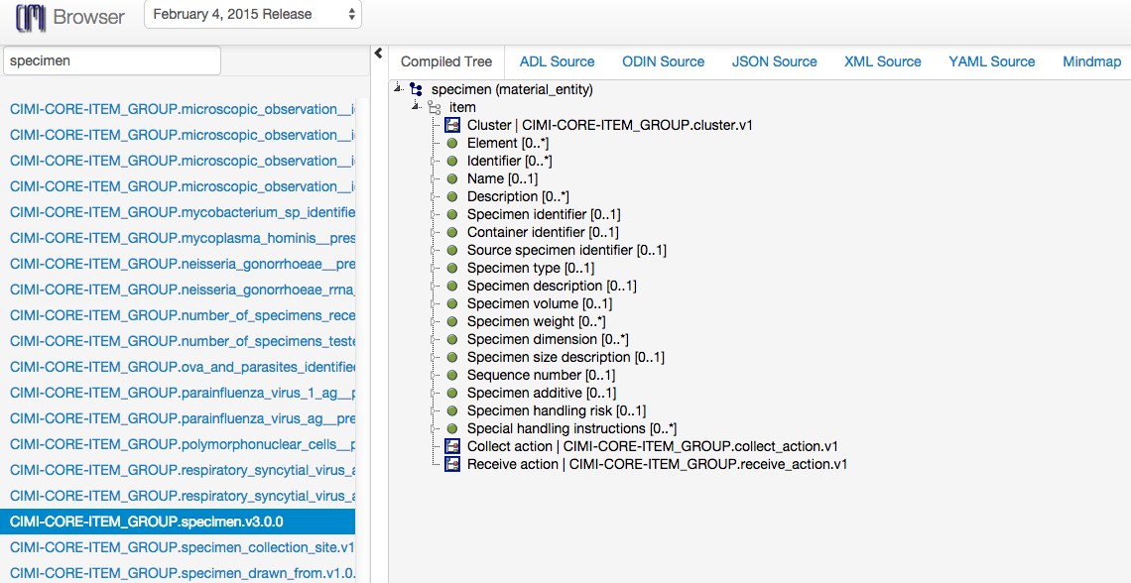
CIMI – Model Browser
Source: http://www.clinicalelement.com/cimi-browser

Slide 27
Frameworks & Tools
Similar Solutions ?
Existing
HL7: Templates.
OpenEHR: Archetype Definition Language (ADL).
GE-Intermountain Healthcare : Clinical Element Modeling Language (CEML).
New
CIMI: Archetype Modeling Language (AML).

Slide 28
HL7 Templates
Templates are similar to Archetypes.
Detailed Clinical Model with HL7 templates.
Bridge the gaps between technical representational formats - HL7 v3 templates and OpenEHR archetypes.
DCM’s in UML
HL7 “Flavored” non-normative UML.
Not sure if is successful?

Slide 29
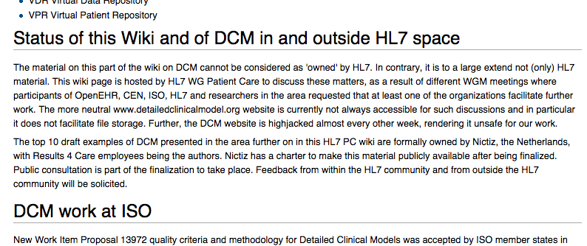
HL7 DCMs

Slide 30
Archetype Definition Language
OpenEHR - http://www.openehr.org
Open source tools by Ocean Informatics
ADL 2.0 (AOM - ADL object model).
Format: ODIN – Object Data Instance Notation.
Proprietary tools to absorb archetypes in ODIN. Open now??
Multiple tools – Editor, ADL Workbench – written in Eiffel language.

Slide 31
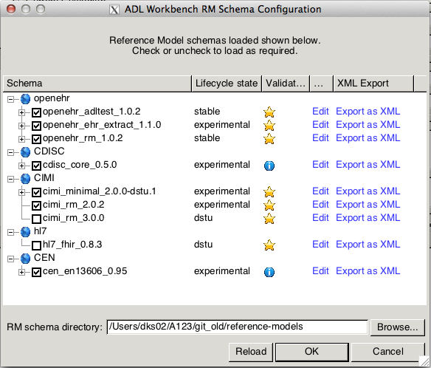
ADL Workbench

Slide 32
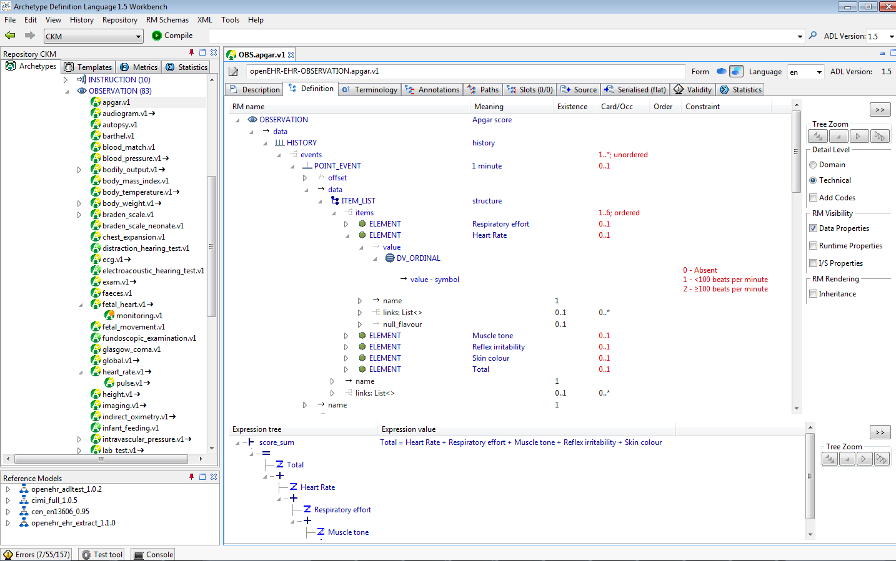
ADL Workbench

Slide 33
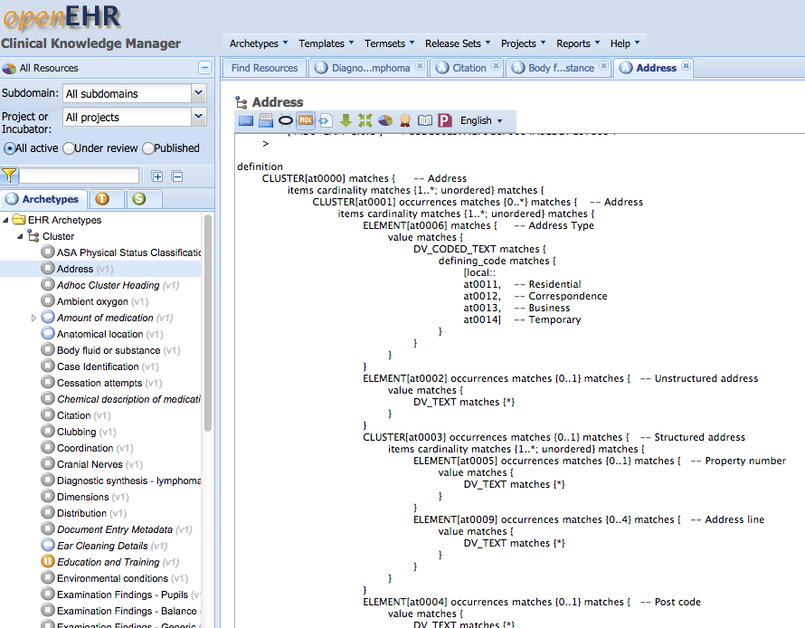
OpenEHR - CKM
http://openehr.org/ckm/
ADL1.5

Slide 34
OpenEHR ADL
Most traction.
Get started with rich set of tools.
Leverage with existing archetypes.
Issues
Proprietary
No easy gateway
Translation needed:
your Reference model to ADL compatible format.
Convert models back.
Challenging setup ?

Slide 35
GE-Intermountain Healthcare
Clinical Element Modeling Language – CEML.
Modeling at IHC
1994 – ASN.1
2000 – XML Schema
2004 – CEML (5000+ Models)
2009 – CDL (Constraint Definition Language)
2013 – Back to CEML
2014 – Converted models to ADL, FHIR profiles
Courtesy: Stan Huff at IHC

Slide 36
GE-Intermountain Healthcare
IHC Models at www.clinicalelement.com
Contributions to:
CEML models to ADL 1.5
CEML models to CIMI
Issues:
CEML (or CDL) compilers → proprietary.
Process to get resources from IHC –
Data normalization working with CEMs (sharpn.org)

Slide 37
Frameworks & Tools
Similar solutions?
Existing
HL7: Templates. ✔
OpenEHR: Archetype Definition Language. ✔
GE-Intermountain Healthcare : Clinical Element Modeling Language (CEML). ✔
New
CIMI: Archetype Modeling Language (AML).

Slide 38
AML : An OMG Standard
Object Management Group (OMG) is a standards consortium.
Preliminary submission in November 2014.
Currently being revised…
AML specification is collection of UML artifacts:
Profiles, stereotypes
Data types
Classes, Packages
https://github.com/opencimi/AML

Slide 39
Unified Modeling Language
UML is an OMG standard.
Creating and exchanging Models.
Create:
Classes
Properties
Associations
Generalization / Specialization
Enumerations
Stereotypes, tags, constraints.
Profiles (domain specific extension).

Slide 40
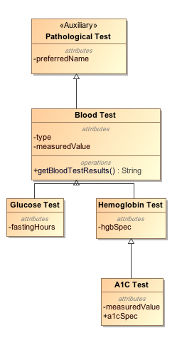
UML Example
Class
Stereotype
Property
Operation
Specialization

Slide 41
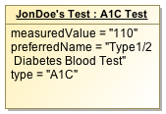
UML Instance Example
Class
Stereotype
Property
Operation
Instance
(of Class “A1C Test”)
Specialization

Slide 42
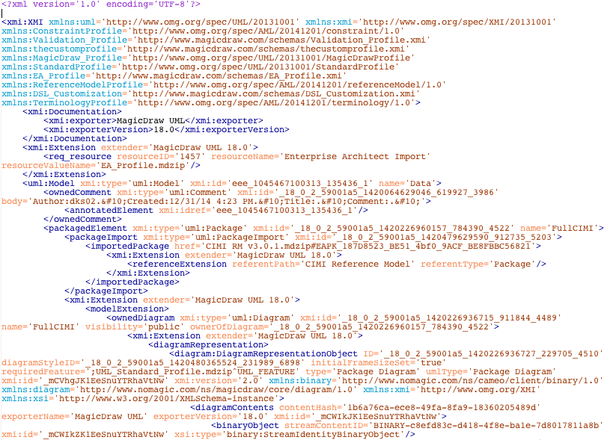
XMI – XML Metadata Interchange
Format for exchange UML models

Slide 43
UML Extension mechanism
UML Meta-model
UML Model
Stereotypes
Tags
Constraints

Slide 44
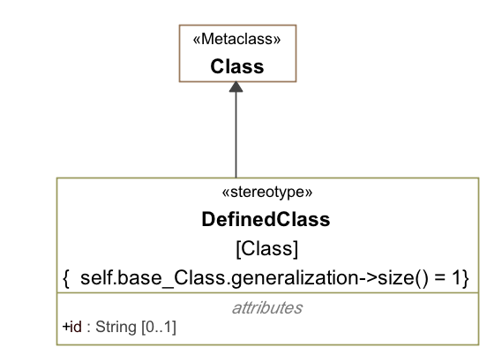
UML Extension mechanism
Restriction
Tag
Courtesy: Harold Solbrig

Slide 45
UML Profile
A Profile is a Collection of Stereotypes and Classes.
The (or “A”) GOAL is to have UML model vendors incorporate profiles as first class items into their tools…
Courtesy: Harold Solbrig

Slide 46
UML Constraints
UML is good at general, “extensible” models.
NOT so good at “constraint” models.
Constraints are in “Object Constraint Language” – OCL:
OMG Standard
Constraint Language of UML
Textual Language to describe constraints, e.g.
Context=Patient{self.age >= “18”}
Context=SingularAttributeConstraint
{(self.base_Property.redefinedProperty->size()=1)and
(self.base_Property.upper=1)}
Courtesy: Harold Solbrig

Slide 47
Archetypes in UML
Advantages:
UML is OMG standard, non-proprietary.
UML is familiar to most modelers.
Model-Driven Architecture/UML tools.
Future CIMI support.
AML allows directly work with UML RMs.
Data Query and Validation
Existing and future UML tools can be used.

Slide 48
Clinical Models
UML Meta Model
AML
RM
MDA
UML Profiles
Application Template
Meta-model
UML
Generate
about
Transform
Clinical Model
Clinical Model
Clinical Model
Application
Clinical Model
UML
Validates
UML
Archetypes
Instance Data

Slide 49
Clinical Models
UML Meta Model
AML
RM
MDA
UML Profiles
Application Template
Meta-model
UML
Generate
about
Transform
Clinical Model
Clinical Model
Clinical Model
Application
Clinical Model
UML
Validates
UML
CIMI Model Repository
Archetypes
Instance Data

Slide 50
Code Generation
MOF
Reference Implementation
UML Meta Model
EMF
EMOF (Ecore)
Eclipse Modeling Framework
AML
RM
MDA
UML Profiles
Application Template
Meta-model
UML
Generate
about
Transform
Clinical Model
Clinical Model
Clinical Model
Application
Clinical Model
UML
Validates
UML
CIMI Model Repository
Archetypes
Instance Data

Slide 51
Inside AML Specifications
UML Meta Model
AML Object Model | AML Profile
Reference Model | Reference Model Profile
Archetype Model | Archetype Profile
Constraint Model | Constraint Profile
Terminology Model | Terminology Profile
Rules Model | Rules Profile
Metadata Model | Identification & Designation
AML
RM
MDA
UML Profiles
Application Template
Meta-model
UML
Generate
about
Transform
Clinical Model
Clinical Model
Clinical Model
Application
Clinical Model
UML
Validates
UML
CIMI Model Repository
Archetypes
Instance Data

Slide 52
Reference Model
Describes the characteristics a target Reference Model (RM) must have in order for the constraint model to refer to it predictably.
Reference Model Profile:
Defines the set of data types whose values can be directly constrained by an AML Model.
It also specifies a small set of stereotypes that are used to "decorate" a reference model and its various components.

Slide 53
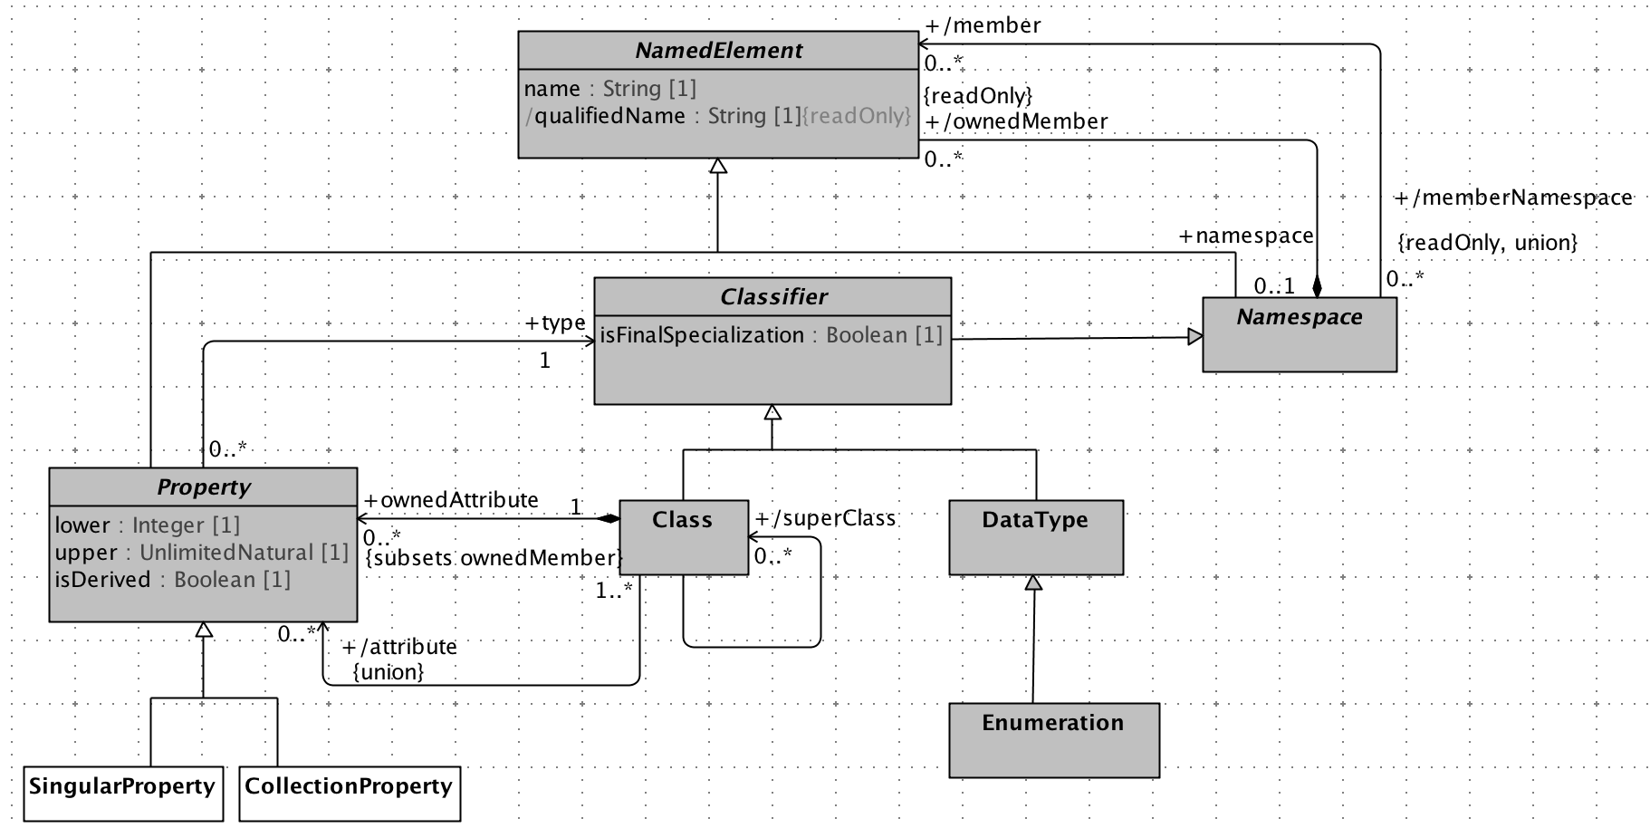
Reference Model

Slide 54
Archetype Model
Defines relationship between archetype libraries, archetypes and archetype versions.
Archetype Profile:
Constraint related to Archetype Library, Archetype and Archetype Version.

Slide 55
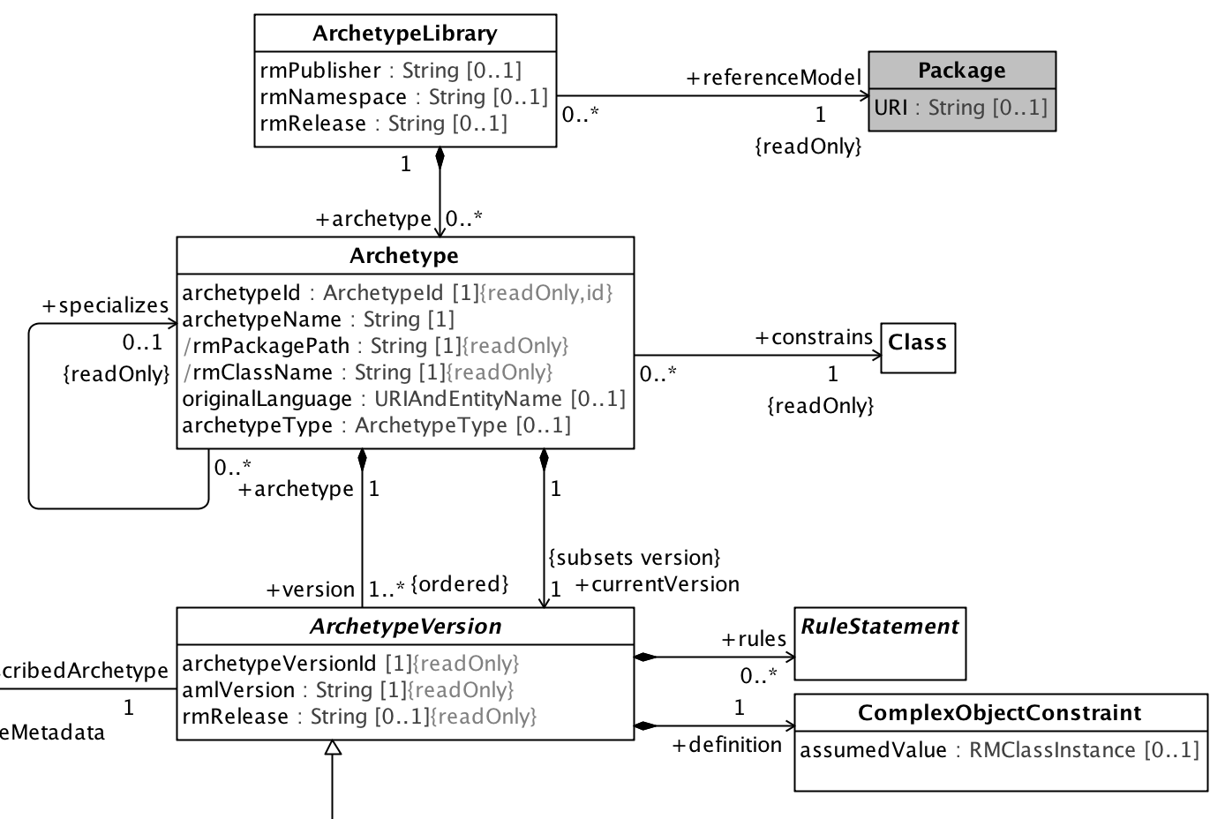
Archetype Model

Slide 56
Constraint Model
Illustrates how constraints are defined. This is core part of the AML specifications.
Constraint Profile:
Defines the modeling elements that may be applied to a reference model and archetype. These elements “constrain” the target model narrowing the semantics and syntax.

Slide 57
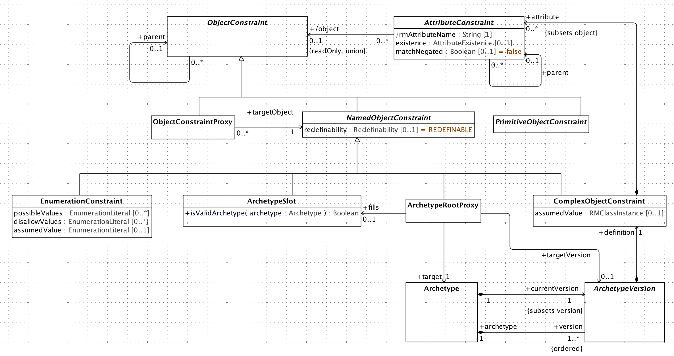
Constraints

Slide 58
Identification & Designatable
Advised by ISO 11179-3
IdentifiableItem
Namespace + id
DesignatableItem
Language + sign + [description]
Namespaces
“meaning” linkage from Class
Courtesy: Harold Solbrig

Slide 59
Rules Profile
Define a common constraint profile, compatible with a subset of OMG – Object Constraint Language (OCL) and covering ADL Rules.
Courtesy: Harold Solbrig

Slide 60
Terminology Profile
Describes how various elements of Standards:
Common Terminology Services (CTS2)
ISO 11179 – Metadata Repository (3rd Ed.)
can be utilized to bind identifiers and terms used (in archetypes) to terminology resources like:
Code Systems
Value Sets and Permissible Values

Slide 61
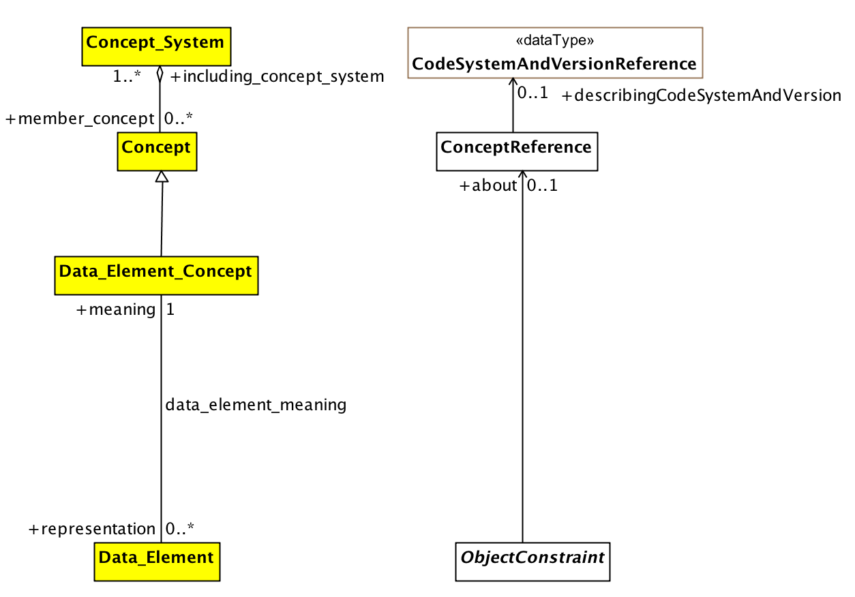
Terminology Profile

Slide 62
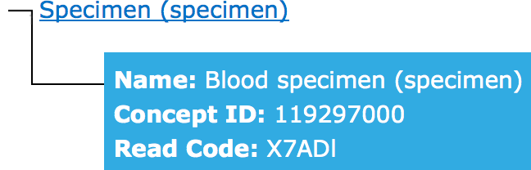
Terminology Binding
Example of term bound to a concept to define it’s meaning:
Blood Specimen – SNOMED ID: 122560006
definedBy
definedBy
ConceptReference
ConceptReference
“blspec001”
“Blood_spec”
Meaning is same

Slide 63
Common Terminology Services 2
CTS2 is a model and specification for discovering, accessing, distributing and updated terminological resources on the internet.
Code Systems,
Terminology Concepts,
Value Sets,
Access with Services API:
REST API implementation to access CTS2 resources
http://informatics.mayo.edu/cts2
OMG Standard: http://www.omg.org/spec/CTS2/

Slide 64
AML Tooling
AML

Slide 65
AML Tooling
AML Archetype Examples – Manually
AML Object Model (AML-OM) is inspired from ADL Object Model (AOM).
Existing ADL archetype → AML archetypes
Traceability Matrix by Harold Solbrig
Map AOM → AML-OM
Developing a converter is first step to visualize a real archetype in AML
Testing AML Capabilities, Validation comes next

Slide 66
AML Tooling
ADL2AMLConverter : ADL → AML
Ingredients:
OpenEHR released Java implementation of ADL 1.5 parser
Archetype Object Model in Java
Provides some validation of archetypes.
Eclipse Modeling Framework (EMF)
ECore Library
MagicDraw Open APIs are based on EMF’s ECore Model
Support UML2 and UML2 Extensions

Slide 67
AML Tooling
Project Location:
https://github.com/semantix/AMLTooling
Sub-projects:
ADL2AMLConverter – The Converter
AML MD Library – AML Wrapper on MD Open API
AML MD Plugin – Menu Plug-in to MagicDraw IDE

Slide 68
ADL2AML Converter
Traceability Matrix
AML
UML
Export to a target format
ADL Objects
AML Objects
ADL2AML
Converter
ADL Parser
MD Open API
ADL

Slide 69
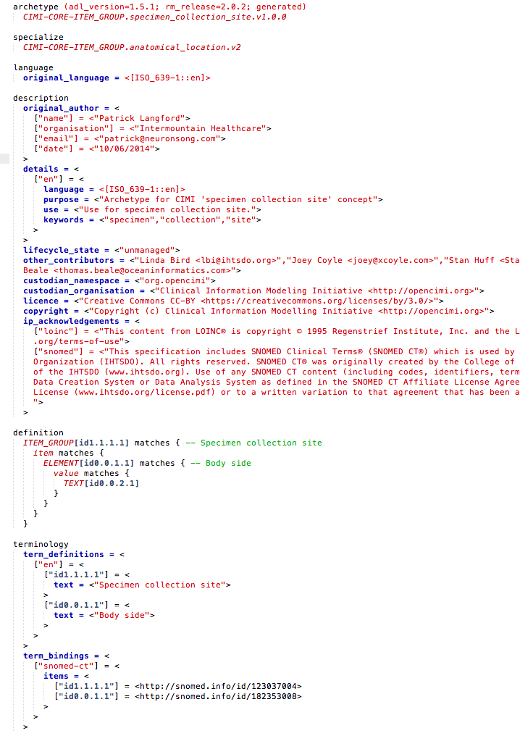
ADL
An ADL file for archetype “specimen_collection_site”

Slide 70
ADL
Archetype Metadata Section
Constraints/Definition Section
Terms & Terminology Binding Section

Slide 71
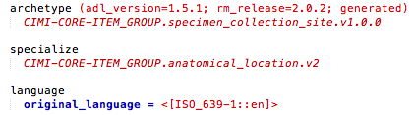
ADL

Slide 72
ADL
publisher
RM Class
Archetype Name
Version

Slide 73
ADL
Specialize
Language

Slide 74
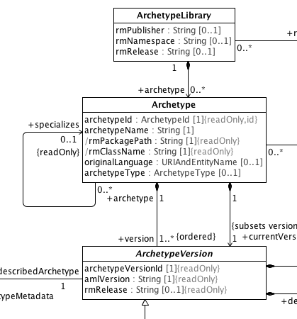
Maps to Archetype Model in AML

Slide 75
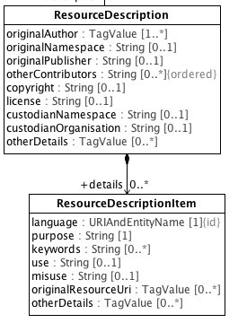
Maps to a ‘Resource’ of Archetype Model in AML

Slide 76
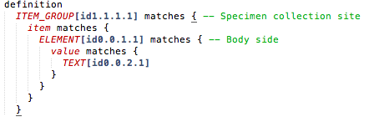
ADL

Slide 77
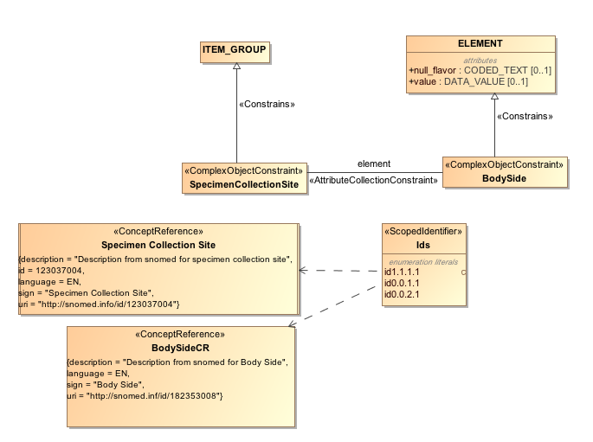
Maps to Constraint Model of AML

Slide 78
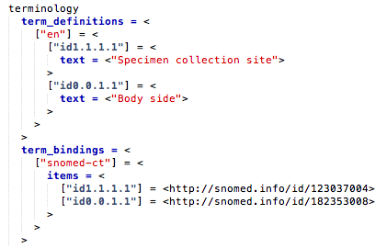
ADL

Slide 79
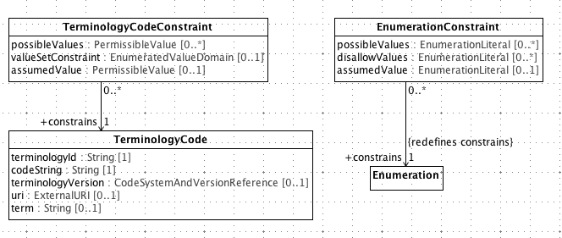
Maps to Terminology Binding Profile of AML

Slide 80
Completed AML Spec./Tooling Tasks
Model 2 Text Transforms:
Completed IBM RSA Business Intelligence Report Tool (BIRT) Template to dynamically generate specifications.
Completed Apache Velocity Template – when moved from IBM RSA environment to MagicDraw.
Developed AML API Layer over MagicDraw OpenAPIs.
Managed AML Model EA -> RSA -> MD, Release

Slide 81
Acknowledgements
Dr. Chris Chute
Dr. Claudia Neuhauser
Dr. Guoqian Jiang
Harold Solbrig (Mayo Clinic)
CIMI Modeling Task Force.
Dr. Stan Huff (GE-Intermountain Healthcare)
Dr. Susan Van Riper (University of Minnesota)

Slide 82
Thank You
Thank you!!
Q&A

